Slide 1
Title
Subtitle (optional) Full name and Credentials

Slide 2
Understanding ACT
New interventions Leo Debroeck, MS, LMHC, CMHS, MHP

Slide 3
Context Lens: Presenter information
Bio must include:
Full Name
Credentials/licensure information
Work experience (including duration)
Highest Education level
Place of highest education level
Any other relevant things to help viewers understand your ‘lens’ or view of the world.
Contact info preferably email or website (Optional)

Slide 4
Context Lens: Presenter information
I am, Leo DeBroeck, a Child Mental Health Specialist and Licensed Mental Health Counselor in Washington State. I am CBT Plus certified through the University of Washington and Harborview Sexual Assault and Traumatic Stress Center. I’ve worked full-time at a community health center as a Mental Health therapist with a team of other Licensed Marriage and Family Therapists. I have previous experience working with children and adolescents at an intensive inpatient program in Spokane, Washington for several years. I have completed my Masters of Science in clinical psychology at Eastern Washington University with my thesis on factors in suicide. I have published scientific research on young adults related to suicidality. I write and have published children's therapy books for use in counseling settings. These are published on Amazon, for use in therapy settings addressing grief, addiction, neglect, abuse, self-confidence and others. I own and founded an LLC called Counselor's Choice Award that reviews counseling products and therapeutic tools. In the past, I have worked in several different levels of care for mental health treatment including long-term inpatient care, WISe wraparound intensive services, school-based therapy services, and outpatient clinical settings.
Contact Email: Leo.DeBroeck@CounselorsChoiceaward.com

Slide 5
Disclaimers:
Disclose all conflicts of interest you may have. Promotional material embedded into the course is not allowed and will mean the course cannot become accredited. If you would like to let people know where to get more resources related to your own material, it needs to be relevant. Unrelated material self promotion can be presented at the end after all material is covered but the time spent cannot count toward the credit hours for the course and cannot take up more than 5 minutes. This must include the following at a minimum:
We will be talking about serious matters which may include death, murder, suicide, rape, war, child abuse, terrorism, drug use, domestic violence, injustices, and others.
Replication, duplication, or recording of the material in any way without written permission is prohibited.
This presentation is intended for educational purposes not for general public practice or news outlets.
Any person(s) information shared is changed in order to maintain confidentiality and privacy laws and are for illustrative purposes and not meant to be taken out of context or as direct recommendations.
You are responsible for your actions. This training will not make you an expert or specialist and always use professional supervision and consultation.
I have no conflicts of interest to declare.

Slide 6
Disclaimers:
We will be talking about serious matters which may include death, murder, suicide, rape, war, child abuse, terrorism, drug use, domestic violence, injustices, and others.
Replication, duplication, or recording of the material in any way without written permission is prohibited.
This presentation is intended for educational purposes not for general public practice or news outlets.
Any person(s) information shared is changed in order to maintain confidentiality and privacy laws and are for illustrative purposes and not meant to be taken out of context or as direct recommendations.
You are responsible for your actions. This training will not make you an expert or specialist and always use professional supervision and consultation.
I have no conflicts of interest to declare.

Slide 7
Content and Objectives
A minimum of 3 objectives and then at least 1 for every additional hour. These must be specific, relevant, and obtainable
Objective 1) Learner will be able to
Objective 2) Learner will be able to
Objective 3) Learner will be able to

Slide 8
Content and Objectives
Objective 1) Learner will be able to understand the basic core components of ACT
Objective 2) Learner will be able to understand at least 1 intervention which ACT uses to help clients
Objective 3) Learner will be able to discuss the ACT Model
Objective 4) Learner will be able to understand how ACT is different from CBT
Objective 5) Learner will be able to understand how homework with ACT is different from CBT

Slide 9
Introduction
Question to let participants know that the course material is starting. (TIP: It should not take more than 5-8 minutes of introduction by the time you reach this slide)

Slide 10
How ACT can help
What are the components to ACT and how do I use them with my clients?

Slide 11
Areas of focus
To Do List
1-3 Objectives (summarized 1-5 words)
1-3 Objectives (summarized 1-5 words)
Research

Slide 12
Areas of focus
To Do List
Understanding ACT
Act Intervention Concerns
Research

Slide 13
NAME from Areas of Focus Slide
5-8 questions related to content that help participant meet those objectives. As an expert in this area, think of questions like “What do I wish I knew when I started?” “What is an intervention I use the most” “What is most important to know in this line of work” “What’s some of the biggest mistakes I’ve made with this?” “What’s the most important thing I’ve learned or my greatest success?” Superlatives don’t always make the best questions directly but they can lead to some good questions.

Slide 14
Understanding ACT
What is ACT anyway? In a nutshell?
What is an example of an intervention for ACT?
What does the client do in ACT?
What does the clinician do in ACT?
What does the “Acceptance” and “Commitment” mean in ACT?
Why does it work?
Is it better than CBT or does it depend on the client? If so, what factors?

Slide 15
Name for Areas of Focus Slide
5-8 questions related to content that help participant meet those objectives. These can be more related to hesitancies, areas of caution, pit falls, when NOT to use the intervention, cultural and ethical concerns, etc.

Slide 16
Act Intervention Concerns
Does it really work though?
What if they don’t like it?
Is it really therapy if it’s something they could just do on their own at home? Should this really be homework for outside of session?
Isn’t it easier to just talk through it instead of ACT?
Should clients really “Accept” or is it better to not in some cases?

Slide 17
Subtitle: Video name or case study
Graphics are a personal preference to help break things up
Videos can work too but they can’t be too long. Try to limit it to a max of 8 minutes long.
Case Studies and specific examples are also a great way to help the learner understand

Slide 18
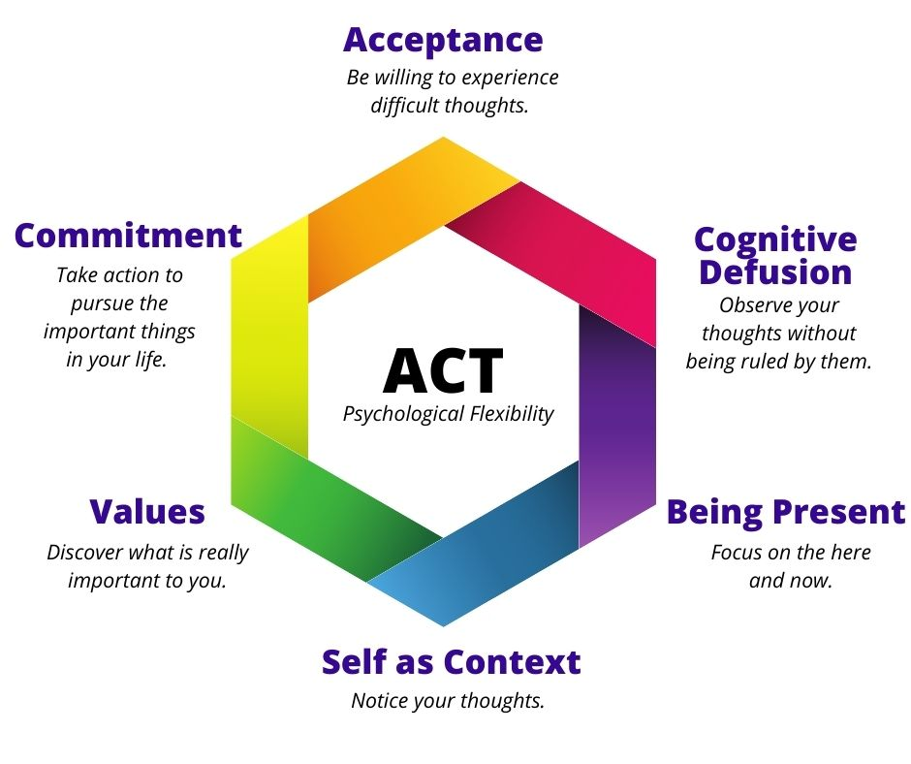
Example Stories
Caregiver addiction
Grief
Confidence

Slide 19
Research
Question the research answers
Summary of research. You don’t have to read out loud the wall of text. Your participants are most likely literate and can read it themselves. Give it to them in your own words and why that research matters.
Citation for article #1 in APA format

Slide 20
Research
Does it work?
As evidenced across 20 meta-analyses, 133 studies, and 12,477 participants, ACT is efficacious. The evidence suggests that ACT is efficacious across a broad range of intervention targets (e.g., diagnoses of mental disorders and health conditions such as chronic pain), with largely equivalent results across these areas. As expected, effect sizes were larger when compared to inactive control groups and smaller when compared to active control groups.
18 studies with 1,088 participants were included in the review….suggested that ACT was significantly for reducing depressive symptoms compared with the control group, especially at three months of follow-up, adult group and mild depression. More research is needed to investigate the difference effects for minor group, moderate and severe depression and long-term follow-up.
Gloster, A. T., Walder, N., Levin, M. E., Twohig, M. P., & Karekla, M. (2020). The empirical status of acceptance and commitment therapy: A review of meta-analyses. Journal of Contextual Behavioral Science, 18, 181-192.
Bai, Z., Luo, S., Zhang, L., Wu, S., & Chi, I. (2020). Acceptance and commitment therapy (ACT) to reduce depression: A systematic review and meta-analysis. Journal of affective disorders, 260, 728-737.

Slide 21
Research
Different Question the research answers
Summary of research.
Citation for article #2 in APA format

Slide 22
Research
What about internet-based?
Across 25 studies, small pooled effects were found for all outcomes at post-assessment and maintained at follow-up time-points. Interventions with therapist guidance demonstrated greater effectiveness in improving depression and psychological flexibility outcomes compared to nonguided iACT, and populations defined by a psychological condition or symptoms (e.g., depressed samples) demonstrated greater improvements in anxiety compared to nonclinical or somatic populations (e.g., chronic pain samples or students). Participants completed on average 75.77% of iACT treatments.
Thompson, E. M., Destree, L., Albertella, L., & Fontenelle, L. F. (2021). Internet-based acceptance and commitment therapy: a transdiagnostic systematic review and meta-analysis for mental health outcomes. Behavior Therapy, 52(2), 492-507.

Slide 23
Research
Different Question the research answers
Summary of research. You will only need about 2-3 pieces of research per 1 clock hour of material. You don’t need to directly discuss it but for accreditation you do need to address the evidence you’re discussing.
Citation for article #3 in APA format

Slide 24
Research
Is it better than CBT?
This review aimed to analyze published studies regarding the usefulness of Acceptance and Commitment Therapy, applied on a group basis, in the treatment of anxiety and depression…Those patients who received interventions based on Acceptance and Commitment Therapy showed a better emotional state and greater psychological flexibility than patients in control groups without treatment. No differences are found with Cognitive Therapy and Cognitive-Behavioral Therapy.
Coto-Lesmes, R., Fernández-Rodríguez, C., & González-Fernández, S. (2020). Acceptance and Commitment Therapy in group format for anxiety and depression. A systematic review. Journal of affective disorders, 263, 107-120.

Slide 25
Research
Is it better than CBT?
Three modalities (CBT, ACT, and DBT) of brief, contextual behavioural therapy proved to be useful in decreasing Boarderline Personality Disorder symptom severity and emotional dysregulation, as well as negative interpersonal attachment. These changes were related to the reduction of experiential avoidance and the acquisition of mindfulness skills in all treatment groups, which may explain why no differences between the three different intervention modalities were observed.
Reyes‐Ortega, M. A., Miranda, E. M., Fresán, A., Vargas, A. N., Barragán, S. C., Robles García, R., & Arango, I. (2020). Clinical efficacy of a combined acceptance and commitment therapy, dialectical behavioural therapy, and functional analytic psychotherapy intervention in patients with borderline personality disorder. Psychology and Psychotherapy: Theory, Research and Practice, 93(3), 474-489.

Slide 26
Research
Have an image from the research if possible
Summary of research. You will need at least 2+ citations that are no more than 10 years old from a peer reviewed academic journal. You can still reference and use other resources but they won’t count towards meeting this requirement. (Only primary sources count towards this accreditation standard: No newspapers, No books, No magazine articles, No websites, No blogs etc.)
Citation for article in APA format

Slide 27
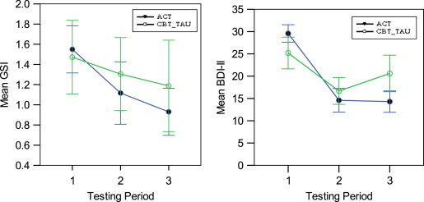
Research
Is it better than CBT?
Of 61 individuals randomized into a service-based trial comparing ACT and Treatment as Usual based on Cognitive Behavior Therapy (TAU-CBT), 45 provided data (ACT n=26; TAU-CBT n=19). Primary outcomes were measures of psychological symptoms. All participants showed reduced symptoms immediately after intervention but improvements were more completely sustained in the ACT group at 6-month follow-up.
Clarke, S., Kingston, J., James, K., Bolderston, H., & Remington, B. (2014). Acceptance and Commitment Therapy group for treatment-resistant participants: A randomized controlled trial. Journal of Contextual Behavioral Science, 3(3), 179-188.

Slide 28
Research
What is the question research answers
Your alma mater may have given you lifetime access to their library system or their librarians may be able to still help you online in finding research.
Google Scholar is a good alternative as well because it allows you to filter for only recent research and systematic reviews or metanalysis have good summaries for these shorter trainings.
Citation for article in APA format

Slide 29
Research
What is the mechanism that makes it work?
Comparing The Efficacy of Acceptance and Commitment Therapy (ACT) and Dialectical Behavior Therapy Skills Training (DBT-ST) on Cognitive Emotion Regulation in Patients with Type II Diabetes: Based on the results of this study, it can be concluded that ACT improved psychological indexes and mental health of patients with type II diabetes due to acceptance of unfavorable emotions and thoughts, commitment, and DBT-ST for emotion regulation and mindfulness components.
Montazernia, B., Koushki, S., Oraki, M., & Mirzaian, B. (2021). Comparing The Efficacy of Acceptance and Commitment Therapy (ACT) and Dialectical Behavior Therapy Skills Training (DBT-ST) on Cognitive Emotion Regulation in Patients with Type II Diabetes. Iranian Journal of Health Psychology; Vol, 4(1).

Slide 30
Conclusion
Conclusion
What do you take out of this?

Slide 31
Conclusion: The Takeaway
Conclusion
In just a couple of sentences, what is the one thing you hope the learner remembers. If they forget all the objectives and the material one year from now, what is the one thing you hope they would remember?

Slide 32
Conclusion: The Takeaway
Conclusion
ACT is a tool that helps clients overcome problems that are beyond their control.
Clients learn to stop avoiding, denying, and struggling with their inner emotions and, instead, accept that these deeper feelings are appropriate responses to certain situations that should not prevent them from moving forward in their lives. With this understanding, clients begin to accept their hardships and commit to making necessary changes in their behavior, regardless of what is going on in their lives and how they feel about it.

Slide 33
Thank you for joining me today
Your valuable time spent will help you be a better helper to others
If you learned anything new, be sure to
tell others what you learned as well!
Presented by: Full Name and Credentials

Slide 34
Thank you for joining me today
Your valuable time spent will help you be a better helper to others
If you learned anything new, be sure to
tell others what you learned as well!
Presented by: Leo Debroeck, MS, LMHC, CMHS

Slide 35
Further Resources
Conclusion
Links to websites, books, research articles, or other tools or handouts can be provided here.

Slide 36
Further Resources
Conclusion
ACT made Simple by Russ Harris
ISBN-10 ‏ : ‎ 1684033012
ISBN-13 ‏ : ‎ 978-1684033010

Slide 37
Conclusion: References
Conclusion
References must be in APA format and alphabetized. Helpful citation machines include: https://www.citationmachine.net/apa You can also use google scholar to get your citation.

Slide 38
Conclusion: References
Conclusion
Bai, Z., Luo, S., Zhang, L., Wu, S., & Chi, I. (2020). Acceptance and commitment therapy (ACT) to reduce depression: A systematic review and meta-analysis. Journal of affective disorders, 260, 728-737.
Clarke, S., Kingston, J., James, K., Bolderston, H., & Remington, B. (2014). Acceptance and Commitment Therapy group for treatment-resistant participants: A randomized controlled trial. Journal of Contextual Behavioral Science, 3(3), 179-188.
Coto-Lesmes, R., Fernández-Rodríguez, C., & González-Fernández, S. (2020). Acceptance and Commitment Therapy in group format for anxiety and depression. A systematic review. Journal of affective disorders, 263, 107-120.
Gloster, A. T., Walder, N., Levin, M. E., Twohig, M. P., & Karekla, M. (2020). The empirical status of acceptance and commitment therapy: A review of meta-analyses. Journal of Contextual Behavioral Science, 18, 181-192.
Montazernia, B., Koushki, S., Oraki, M., & Mirzaian, B. (2021). Comparing The Efficacy of Acceptance and Commitment Therapy (ACT) and Dialectical Behavior Therapy Skills Training (DBT-ST) on Cognitive Emotion Regulation in Patients with Type II Diabetes. Iranian Journal of Health Psychology; Vol, 4(1).
Reyes‐Ortega, M. A., Miranda, E. M., Fresán, A., Vargas, A. N., Barragán, S. C., Robles García, R., & Arango, I. (2020). Clinical efficacy of a combined acceptance and commitment therapy, dialectical behavioural therapy, and functional analytic psychotherapy intervention in patients with borderline personality disorder. Psychology and Psychotherapy: Theory, Research and Practice, 93(3), 474-489.
Thompson, E. M., Destree, L., Albertella, L., & Fontenelle, L. F. (2021). Internet-based acceptance and commitment therapy: a transdiagnostic systematic review and meta-analysis for mental health outcomes. Behavior Therapy, 52(2), 492-507.

Slide 39
CounselorsChoiceAward.com Distinguishing Quality
Products
Services
Continuing Education
Practices
Reviewed by Licensed Mental Health Therapists

Slide 40
Questions? Contact information if you would like participants to be able to reach you with further questions or follow ups
Conclusion

Slide 41
Questions? Contact: LeoDeBroeck@CounselorsChoiceAward.com
Conclusion

Slide 42
1) Course description (At least 2 paragraphs) 2) Course recording (without participant information) 3) Copies of any handouts 4) Copies of these Powerpoints/Slide Deck 5) Post-test and answer key (10 questions for the 1st hour and 5 questions for each additional hour) 6) Your license information: State license and NPI number 7) Your headshot/professional picture That’s all there is to it!
Full List of Requirements

Slide 43
HOW DO I RECORD THE COURSES? If you’ve already taught and recorded the material live, you can just email us and we’ll send a dropbox for you to upload the files. If you’ve never taught before, there are many options. The most popular two are: 1) Record yourself through zoom, google meet, or free OBS Studio while giving the material. This doesn’t have to be all in one sitting either. We can stitch together the recordings so that you can do a little bit of recording between your canceled appointments or a little bit each day. 2) Meet with a member of our team and record the course with an audience of 1 or 2. We’ll handle all the technology and recording details and you’ll have a live audience to ask questions, get feedback, and discuss the material as you’re teaching it.
Note on recordings

